Slide 1
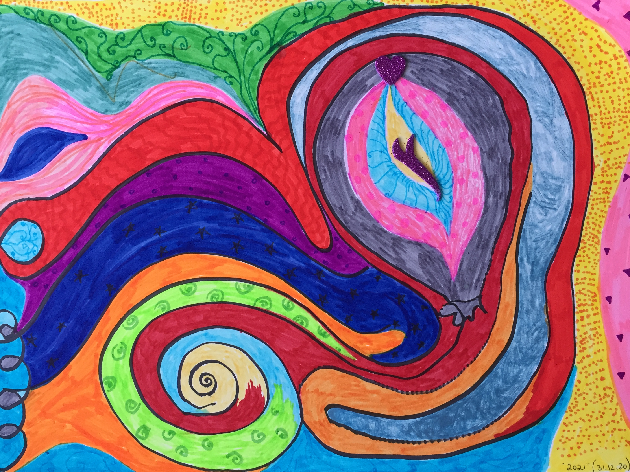
Draw Your Breath:
Promoting observation skills through arts and technologies
A reflective method
Dr. Gil Dekel

Slide 2

Students find
it hard to focus
https://unsplash.com/photos/kqguzgvYrtM

Slide 3
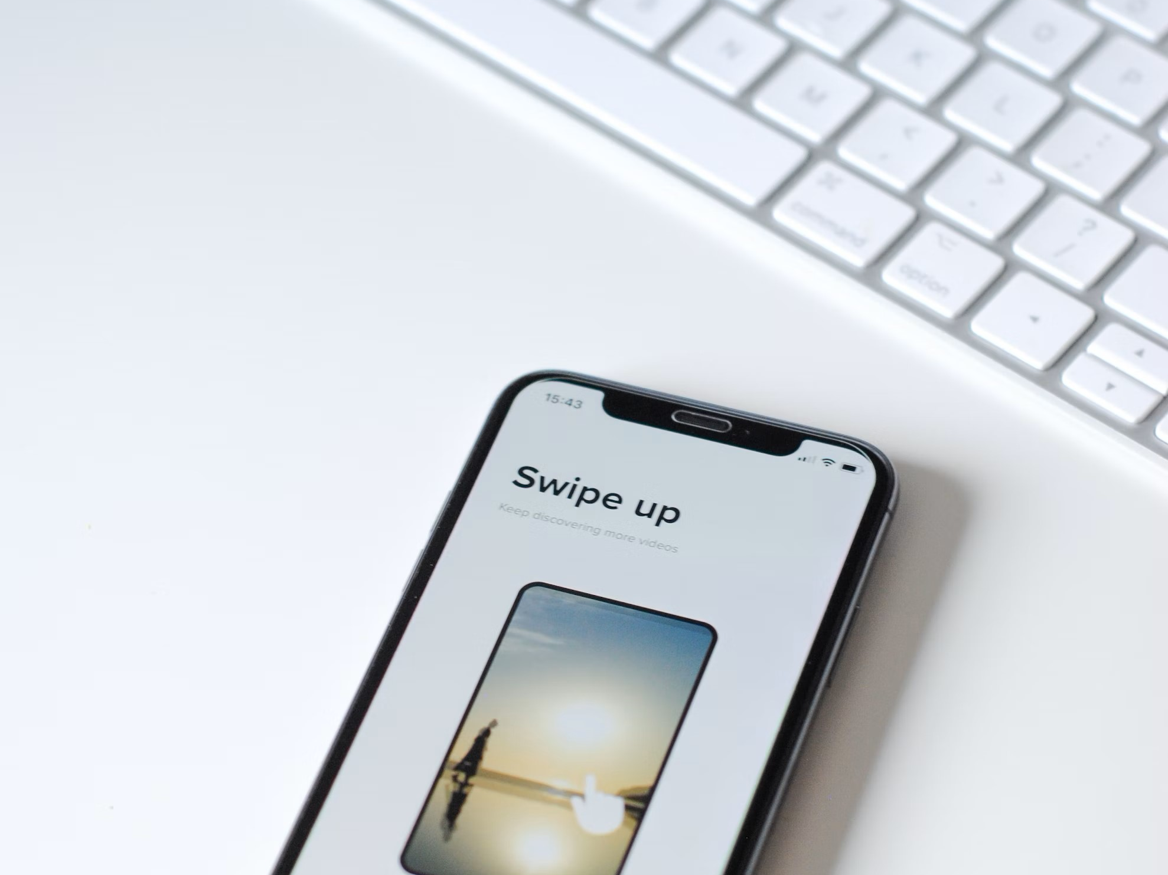
because there are too many distractions.
https://unsplash.com/photos/I-ZZuLNxGfY

Slide 4
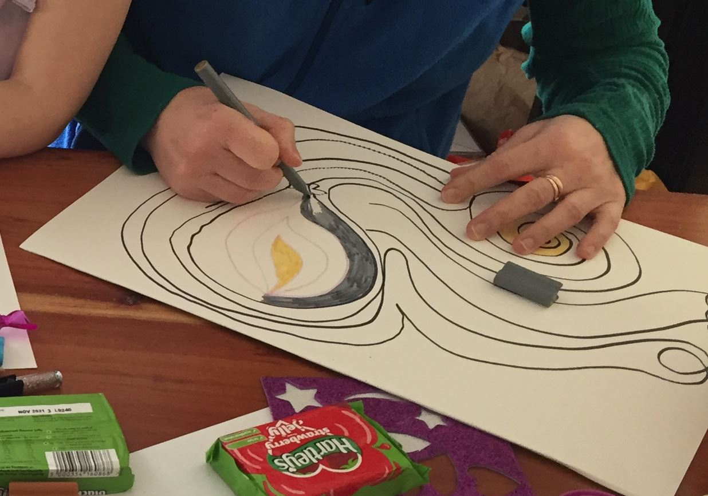
Solution: a reflective method, using
guided meditation
simple arts
technologies
… to build deep relation
Gil Dekel

Slide 5
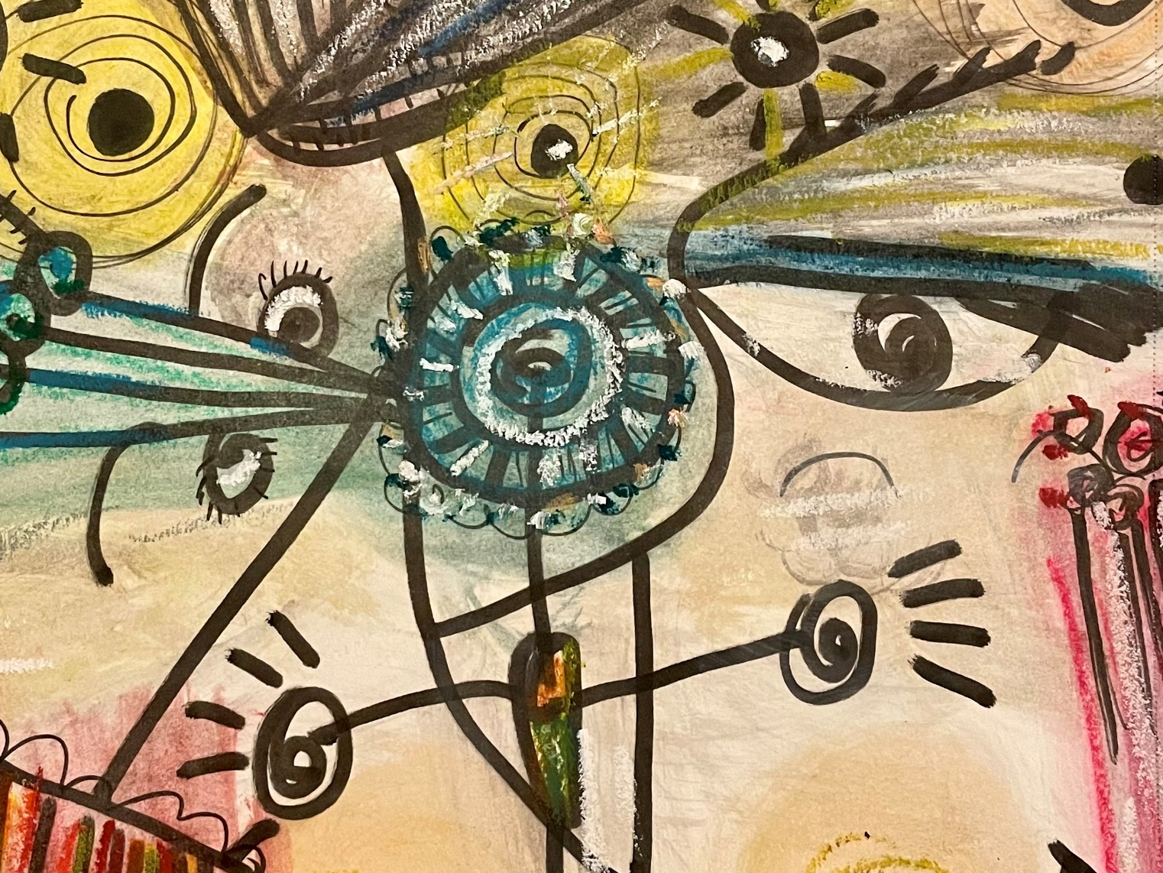
Focus.
Intuitive knowledge.
https://pixabay.com/illustrations/thoughts-thinking-knowledge-7414720/

Slide 6

Engage participants whilst they are still in the relaxed stage.
Body and mind are relaxed.
https://unsplash.com/photos/OEppe6J-Ggc

Slide 7
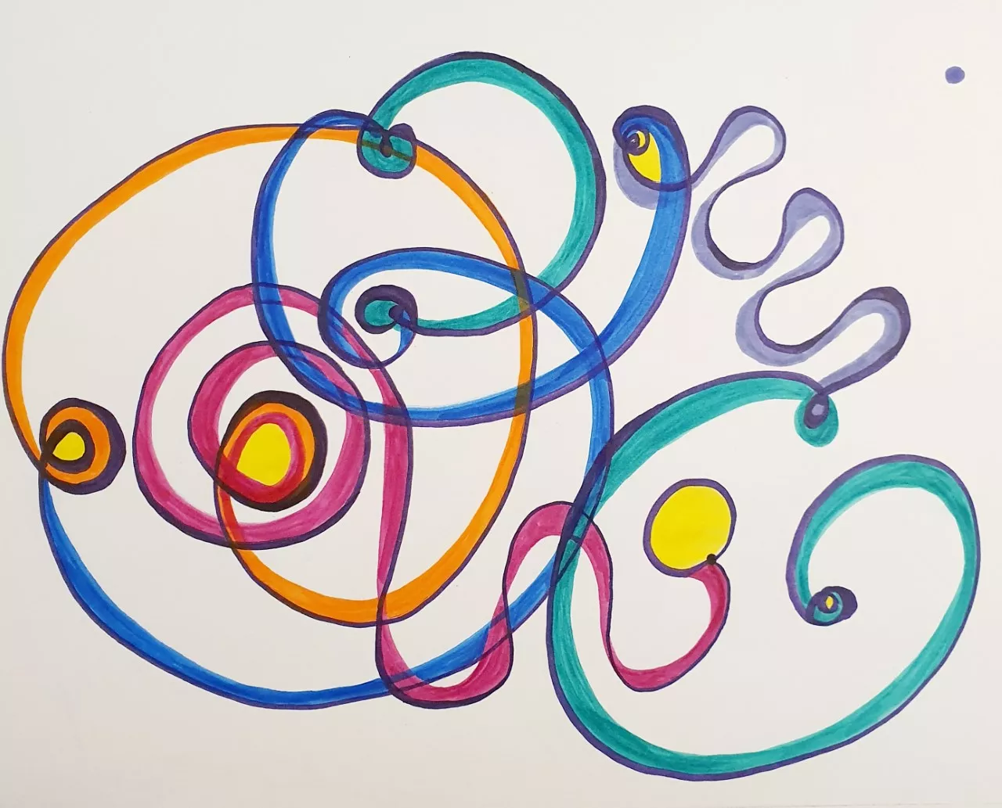
Draw your breathing pattern on paper (you can also colour it).

Slide 8
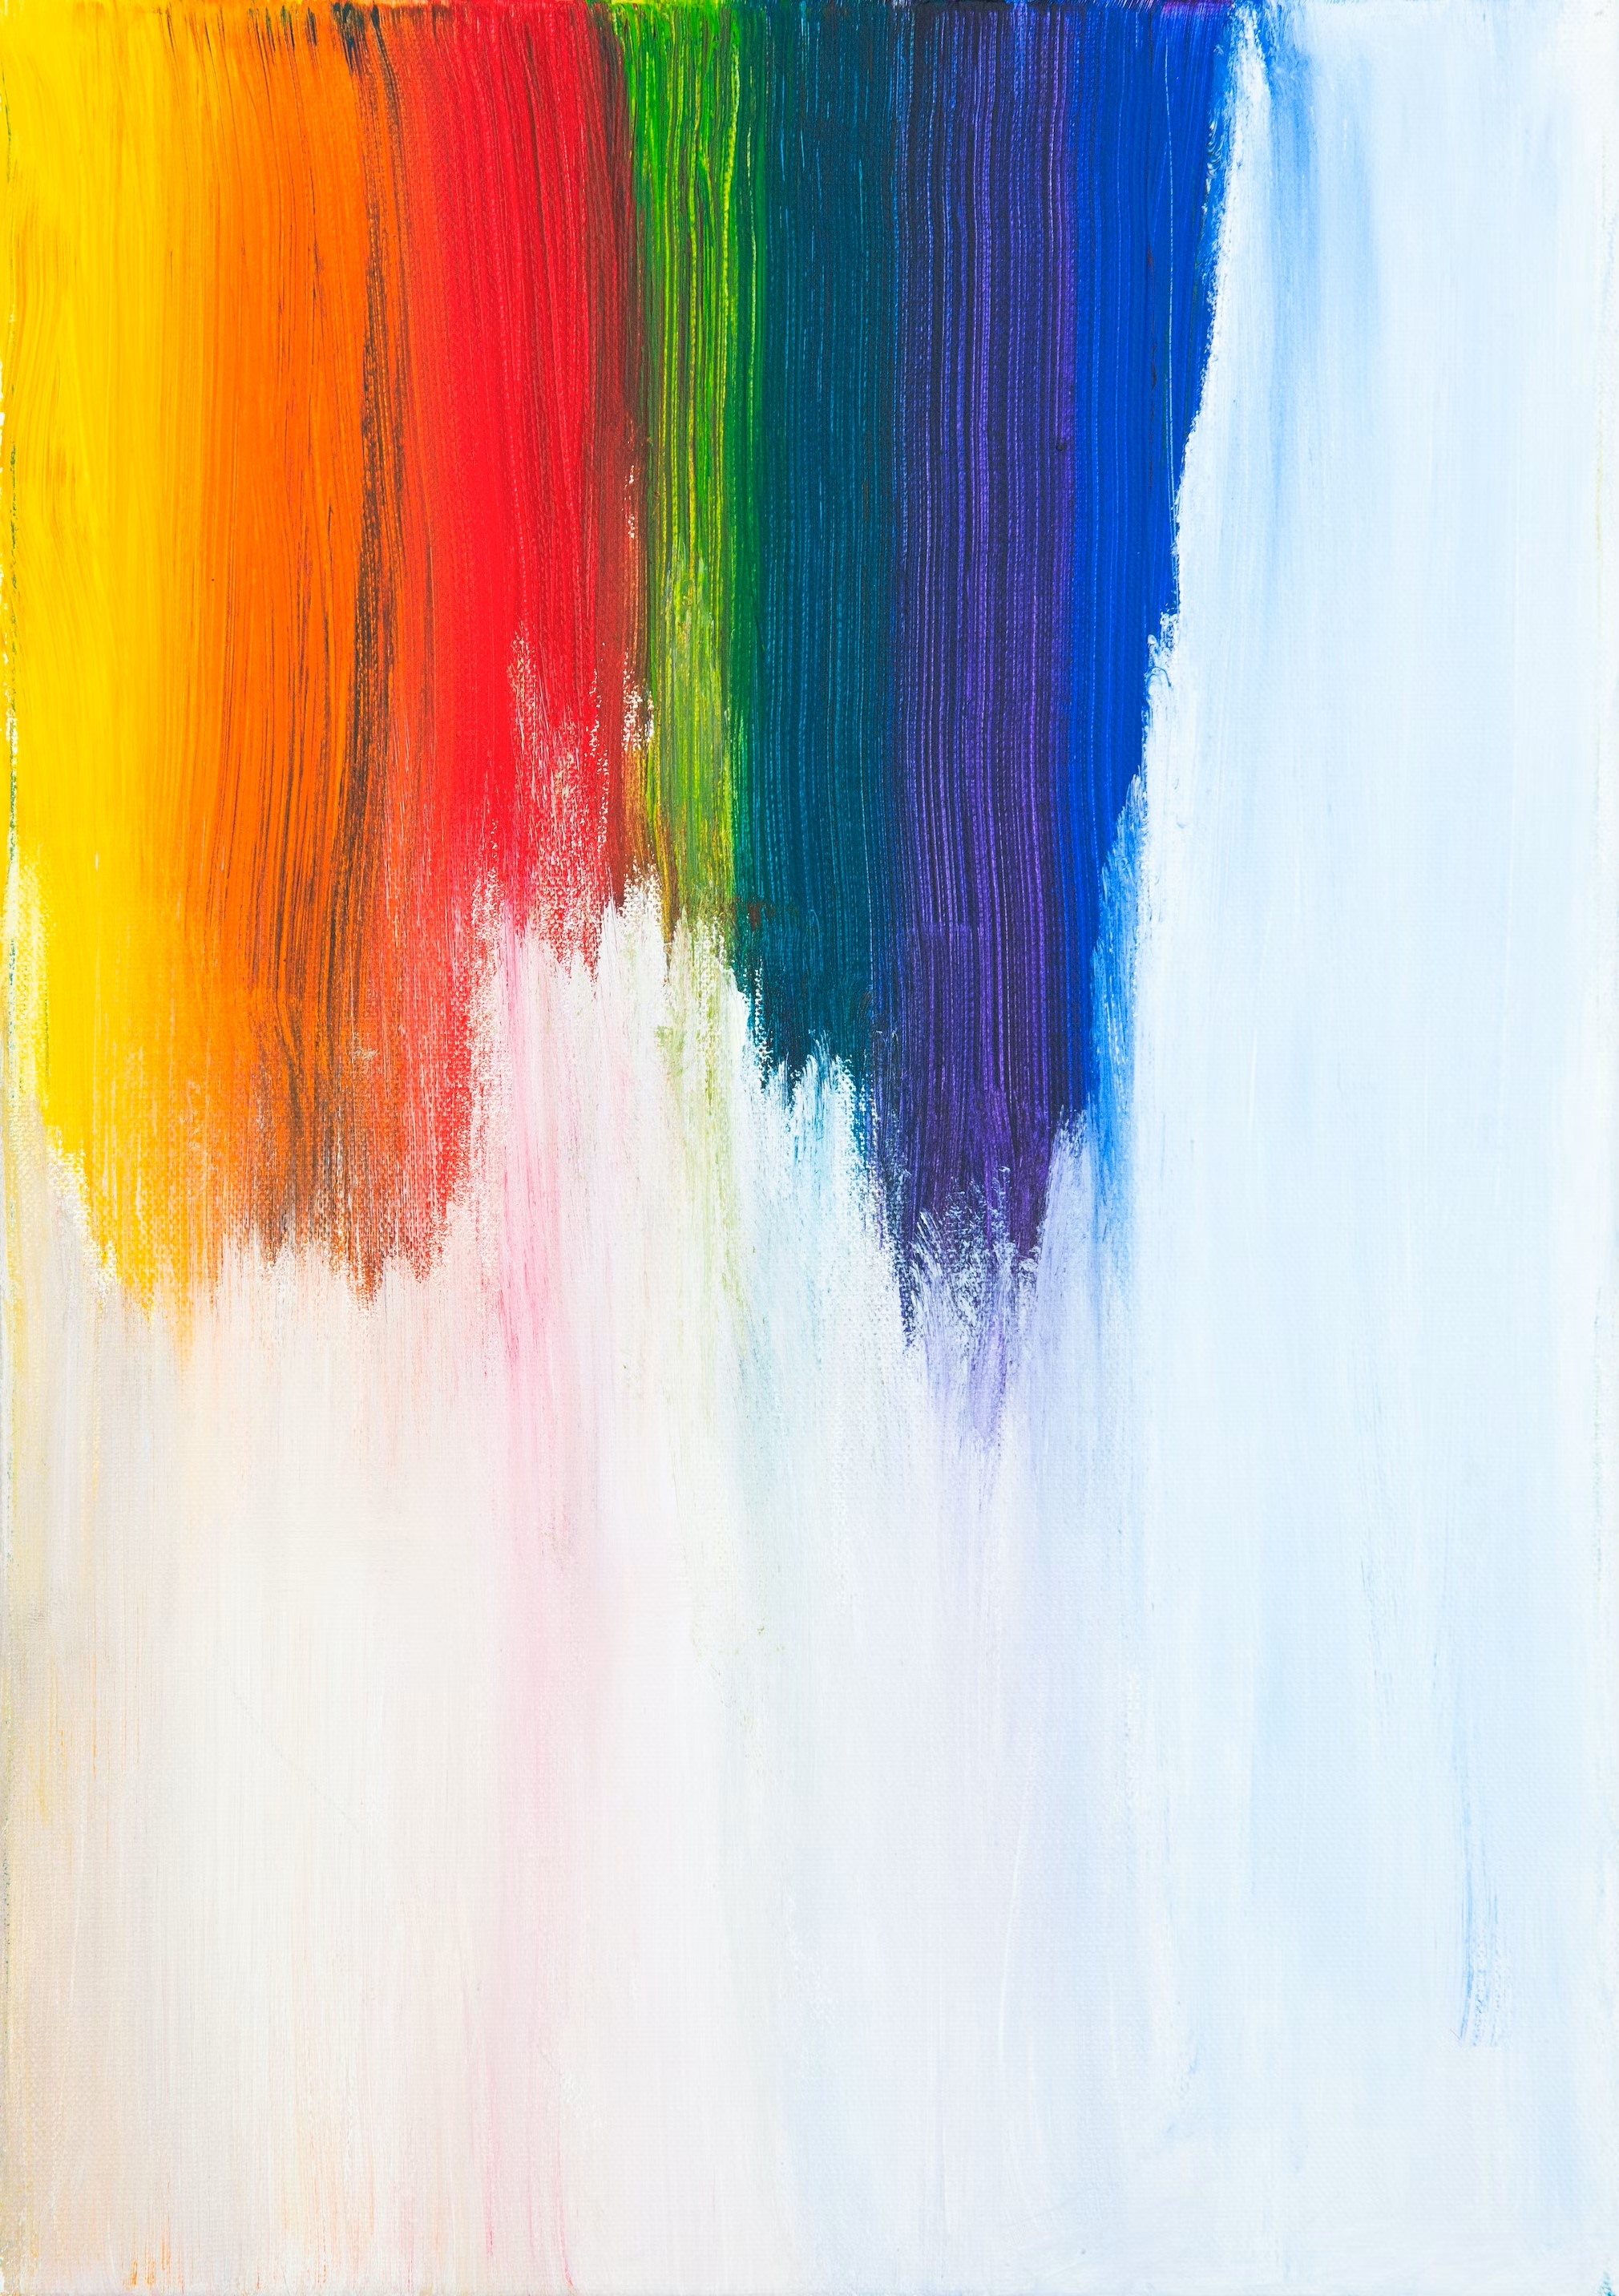
Art practice – helps move people away from their comfort zone.
Breathing - an individual activity; regulates thinking and feelings…
Art + breath = a sense of ownership
https://unsplash.com/photos/k0rVudBoB4c

Slide 9
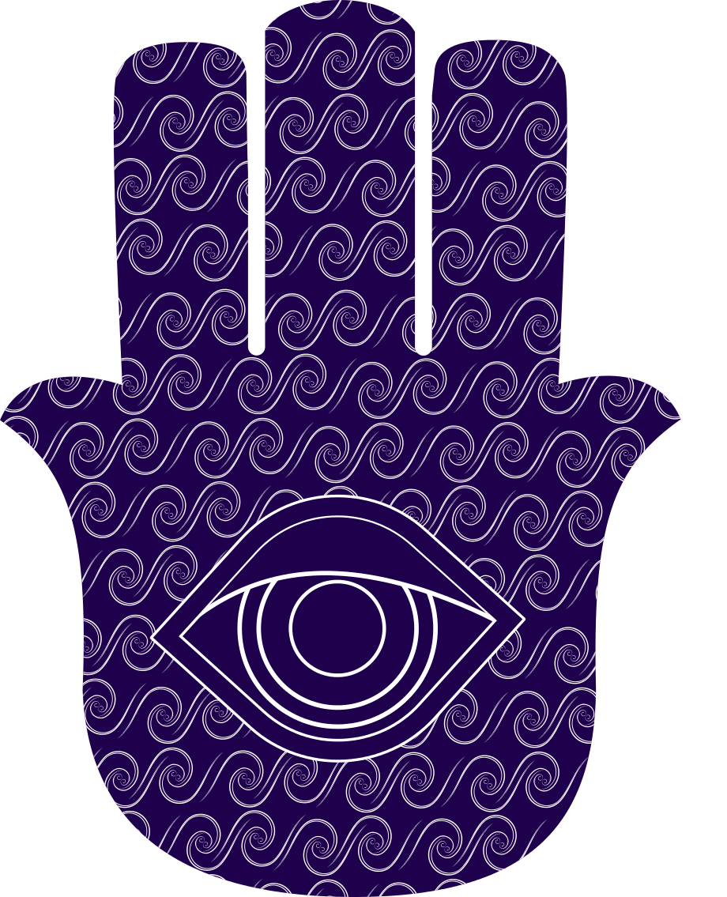
Know Thyself.
constructivist pedagogy - knowledge while reflecting.
https://pixabay.com/vectors/graphic-evil-eye-hand-of-fatima-4092402/

Slide 10
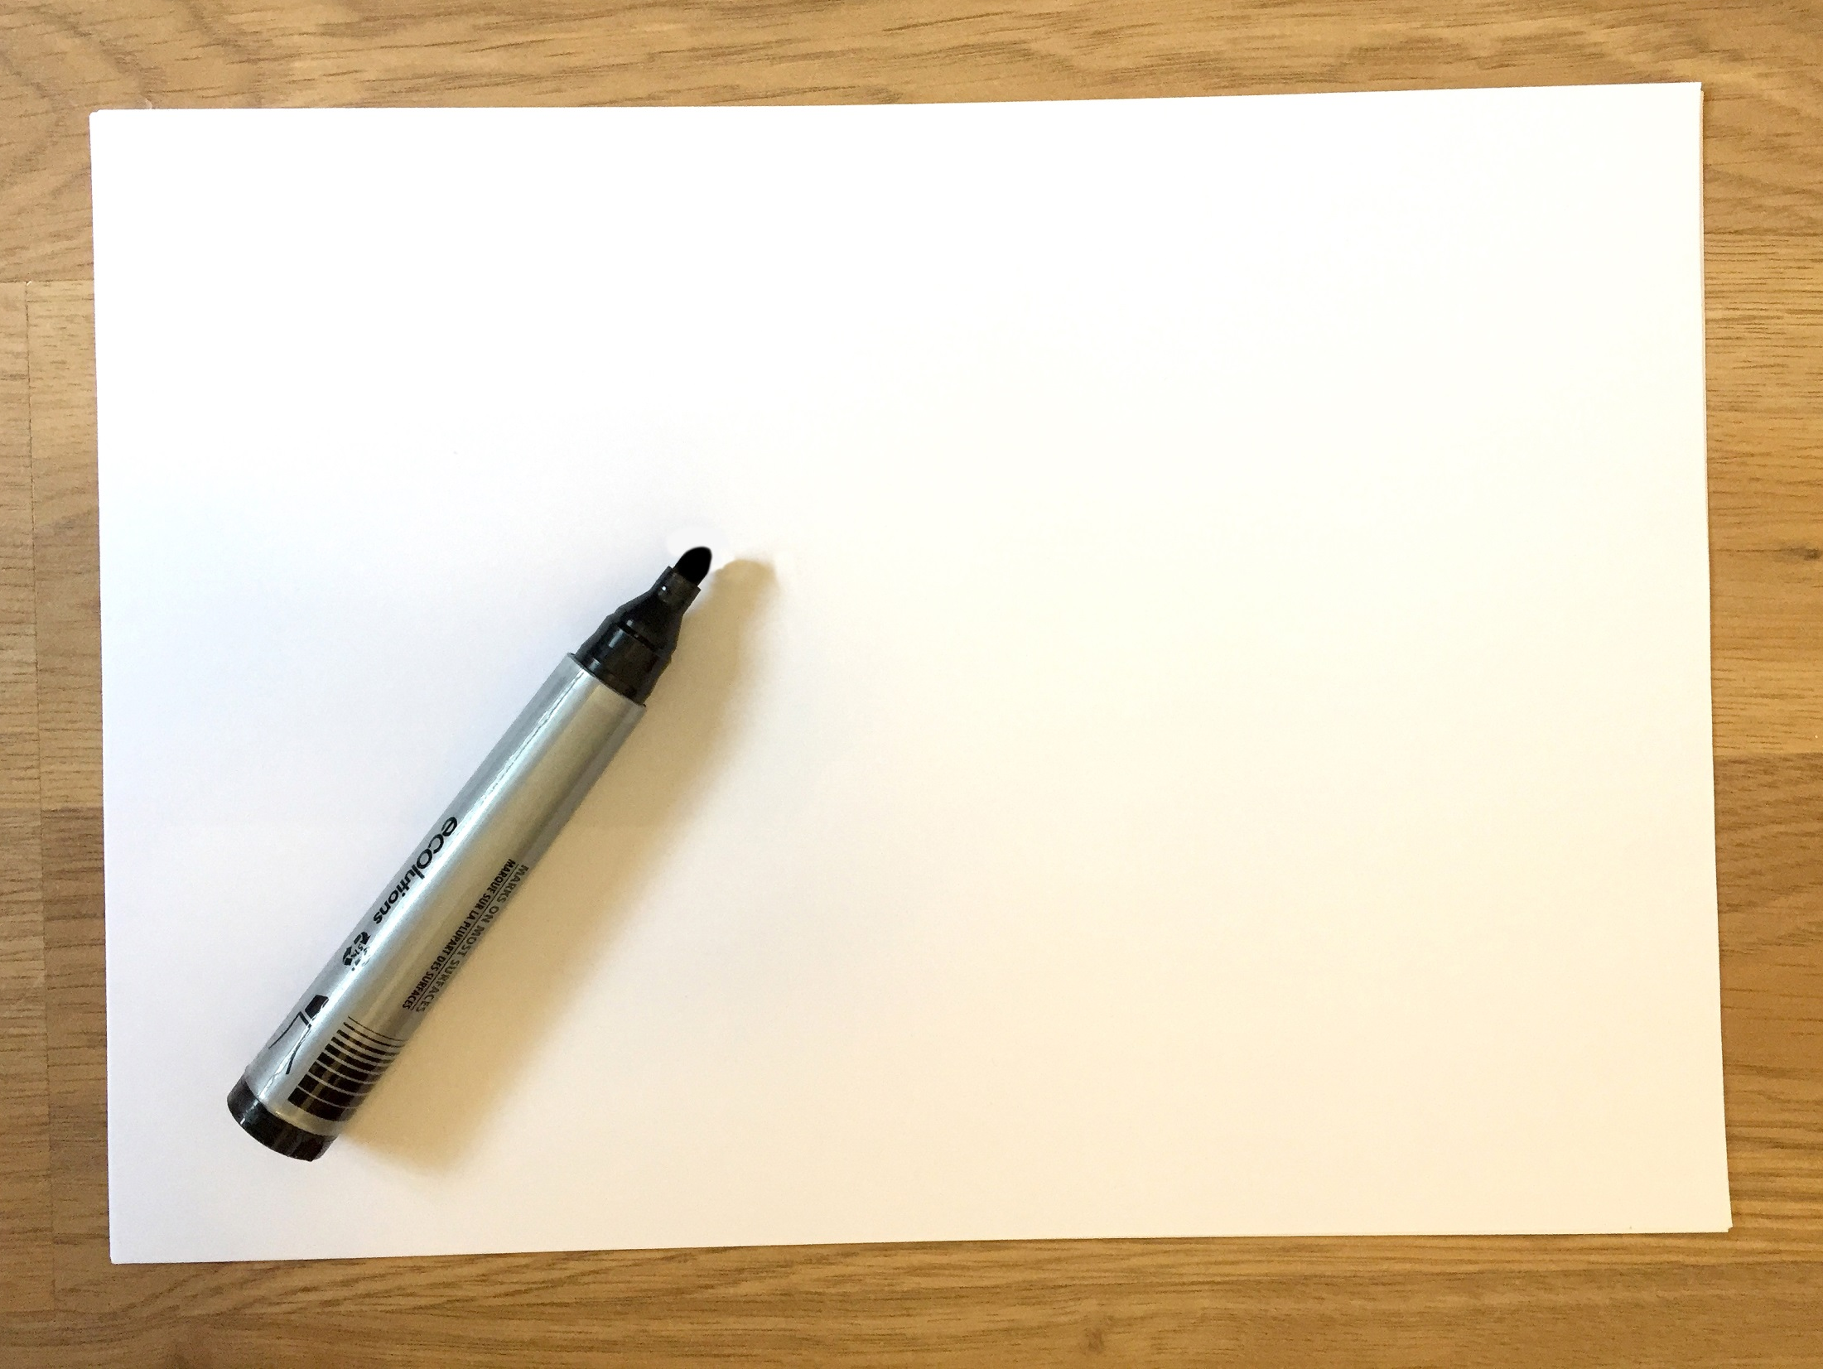
For the activity:
have a black marker,
A3 or A4 Paper
Image © Gil Dekel

Slide 11
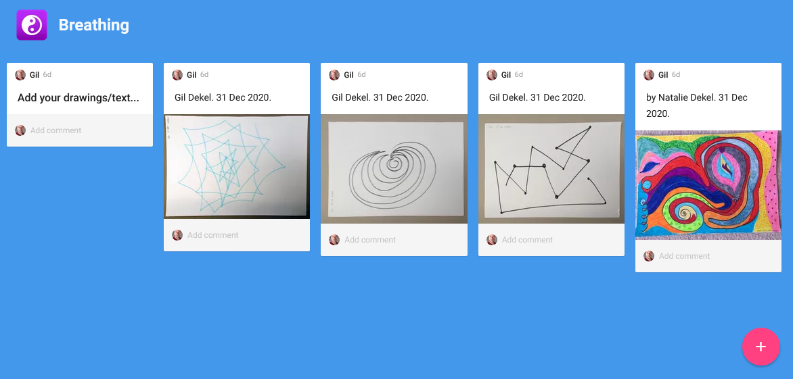
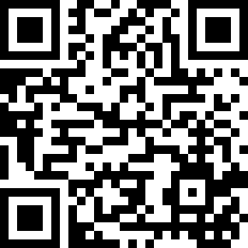
Share your drawing
ncrm.ac.uk/resources/online/all/?id=20812

